Slide 1
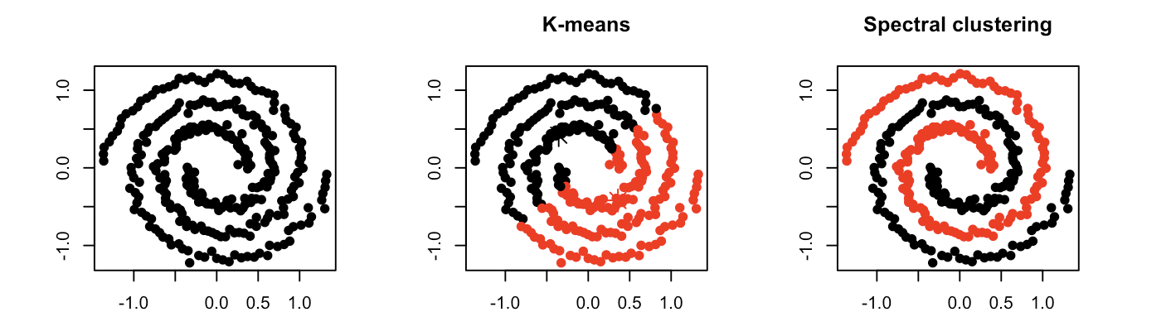
Spectral clustering is a technique with roots in graph theory, where the approach is used to identify communities of nodes in a graph based on the edges connecting them. The method is flexible and allows us to cluster non graph data as well

Slide 2
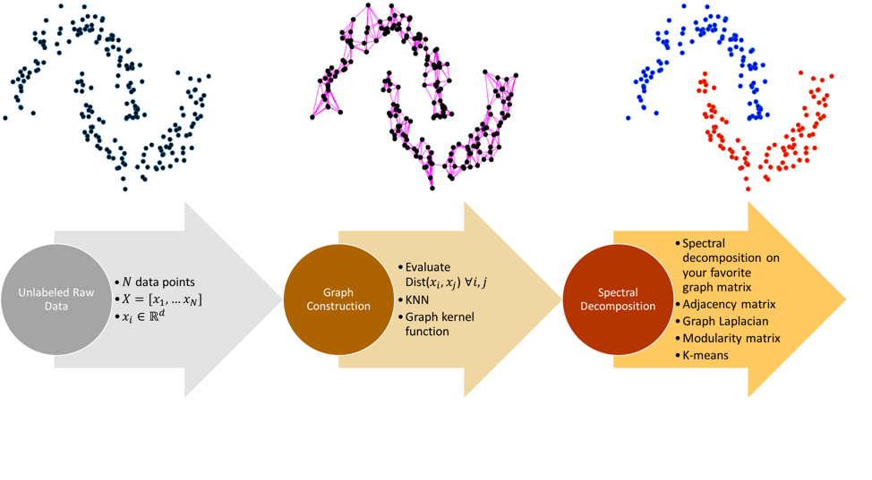
Illustration of how works

Slide 3
